Slide 1
Testing of Automotive Systems
(Part I)
Module 6 –EE System Testbenches
Martin Lamprecht, Magna Steyr

Slide 2
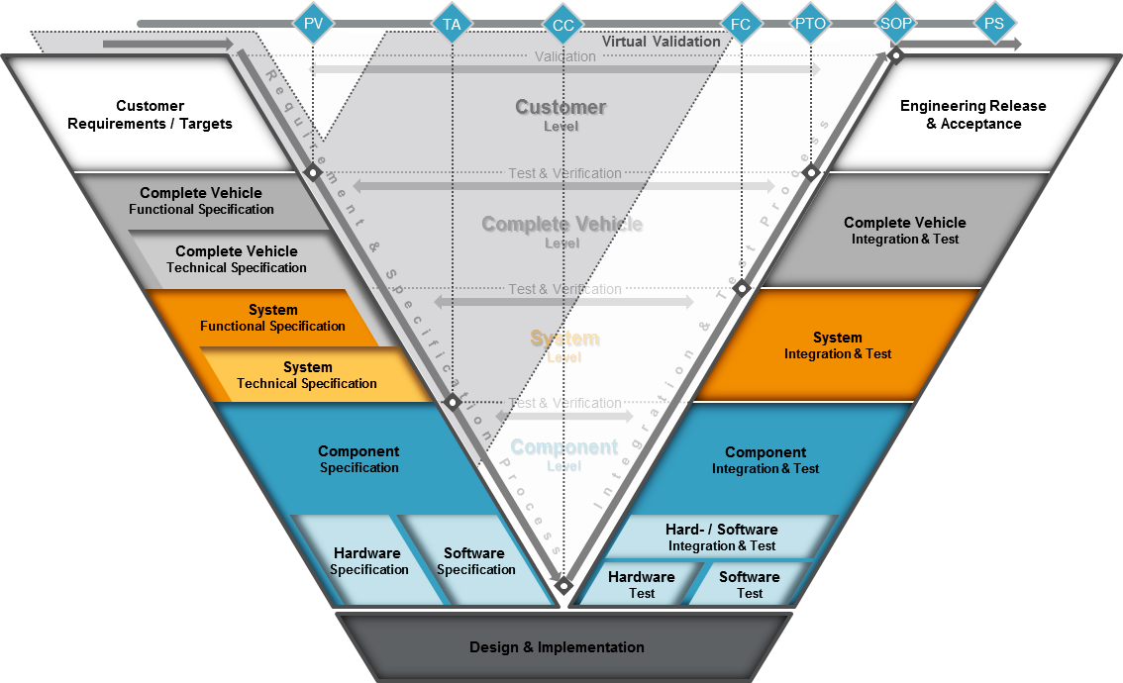
Customer Market Profile
Sales Markets
Configuration List
Feature und Function List
Benchmarks
Vehicle Profile Description
Functional target
achievement confirmed on
customer-ready vehicles
Definition of CV requirements (incl. Legal)
Target setting
Derivation of measureable evaluation criteria
Product & Functional description, HMI-concept
Creation of CV-DVP
Definition of Items and system requirements
Item List
Complete Vehicle Specification Book
Vehicle Target Compliance
Complete Vehicle-Test Program
Complete Vehicle Function Validation
Specification of functional requirements
Specification of technical requirements
Target Setting
Functional assessment
Creation of System-DVP
System Specification Book
Drawings
Serial BOM
System Target Compliance
System-DVP
Testing Standards
Functional System (Item) Validation
Specification of hardware requirements
Specification of software requirements
Target setting
Component Specification Book
Component Targets Compliance
Component-DVP
Hardware Testing and verification
Software Testing and verification

Slide 3
ECU Testing
Hardware

Slide 4
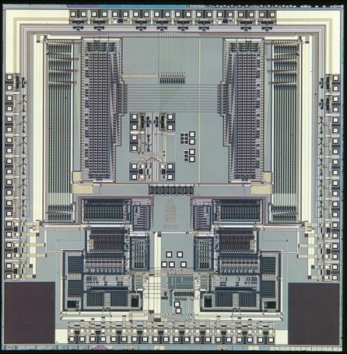
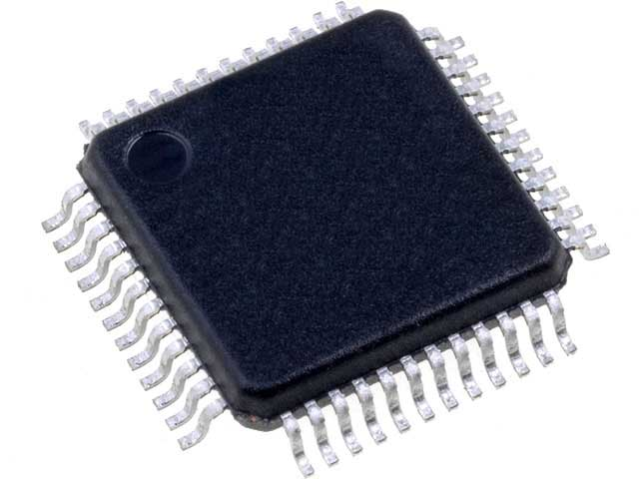
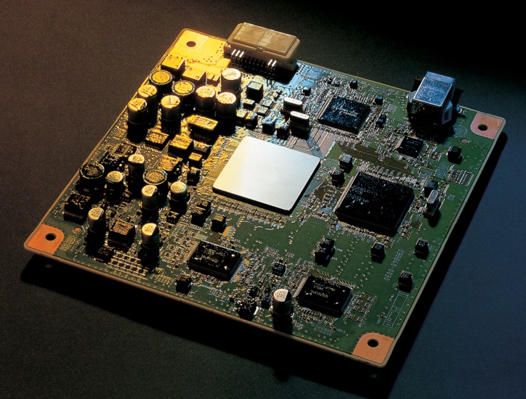
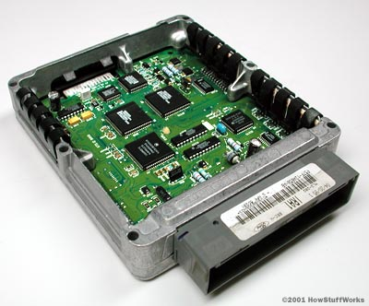
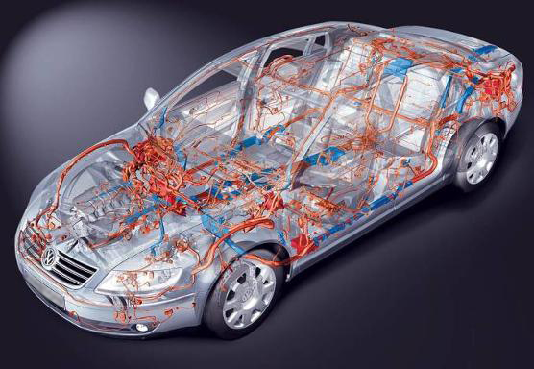
HW Standards : Different level definitions in development with focus hardware
Tier 2
Chip level
Main qualification Spec: AEC-Q
Hardware part level
Main qualification Spec: Set of IPC
Assembly level
Tier 1
Main qualification Spec:
ISO-16750 or OEM equivalent
Component level
OEM
Vehicle/system level

Slide 5
Definition of A/B/C/D/E - Samples
A-Sample (Engineering Sample)
  Main purpose is to show basic communication and some base functionality is already implemented. It could be either a development board or a design intent housing already
B-Sample (DV-Sample)
  All functionality shall be implemented already. All required environmental and EMC tests shall be done.
C-Sample (Off-tool Sample)
  100% Off-tool parts – all functionality implemented as well as all Design Verification (DV) tasks shall be finished.
D-Sample (PV-Sample)
  100% Off-tool and Off-process parts - used to deliver the parts for Product Validation (PV) and Production Part Approval Process (PPAP)
E-Samples (Series Parts)
  Serial production parts with continuous conformity testing (CC)

Slide 6
Sample Description
Sample- Category | Use / Purpose | Quality | Software | Manufacturing | Conditions for approval | Testing
A | First build up of the concept in hardware for the representation of the customer related functions. Object for FMEA. | Customer related functions confirmed. Deviations to specification / functional restrictions are stated in the test report. | Restrictions of functions according specification. Deviations are stated in release notes which are added to the test report. | Hand- work, special manufacturing, modified processes. Partly alternative materials. Rapid prototyping parts. Tacking according internat. standards. | 100% testing of characteristics defined in the prototype control plan | Start of testing at MAGNA in special environment with qualified staff. Hardware is not shipped to the customer.
B | Final hardware. Used for DV testing in an extent that the release of the series tools manufacturing can take place. | Functions confirmed. DV test finalized with positive results. Reliability and lifetime confirmed with defined confidence. Surface not finalized in tools. Deviations to specification / functional restrictions are stated in the test report. | All functions confirmed, which are necessary for the DV testing of the hardware and the operation of the vehicle. All important safety functions confirmed primarily. Deviations are stated in release notes which are added to the test report. | Series related PT building, auxiliary tools (e.g. aluminum or unhardened steel) and auxiliary devices / fixtures. Target: 100% final material. | 100% testing of characteristics defined in the prototype control plan. Prototype process flow chart and control plan supplied | Design verification Testing in vehicles. Defined restrictions for operating
C | Confirmation of final design with parts off tools. Samples for building up the assembly line. Internal release of production process at supplier | Same as B. All functions of the hardware according specification confirmed. Can be flashed in serial production process | Same as B, but all specifications confirmed. All safety functions confirmed. | 100% off tool (not hardened) 100% final material Start-up of series process in series production site | 100% testing of characteristics defined in the series control plan. Series process flow chart and control plan supplied | Testing with parts off serial tools. Testing in vehicles. Defined restrictions for operating
D | PV testing PPAP parts Run at rate Release / approval | Same as C Reliability and lifetime confirmed Short-term process capability confirmed. Parts marked like parts from serial production. | Same as D. Documentation finalized. | 100% final process at 100% cycle time 100% final tools 100% final material 100% series staff 100% series packing MSA done; IMDS done Parts from / after run@rate | Documentation for process and product approval completed | Product validation Assembly in pre-series vehicles
Series P | Serial production Continuous Conformity Testing | Same as D confirmation of long term process capability | Same as D | Same as D | Same as D confirmation of long term process capability | Assembly in serial vehicles for the customer

Slide 7
Test Item | Test against | Target Summary | Main Characteristics | Test Bench
Hardware Unit and Integration Testing (HWIT) | Hardware Detailed Design | Verify HW design decisions, functionality | White-box, low level, Hardware | Basic measurement tools, normal working place
 | Hardware Architecture Spec | Interfaces between HW Units / Components | White-box, Hardware Component level | Basic measurement tools, normal working place
Hardware Tests (HWT) | HW Requirement Spec | Verify requirements | Mainly black-box | Normal working place HiL Special Lab (climatic, mechanical, chemical chambers
Qualification of HW Comp. | Integrated HW components | Suitability for usage | Testing (functional, climatic…) Analysis (simulation, extrapolation…) | Special Lab (climatic, mechanical, chemical chambers Computer workplace

Slide 8
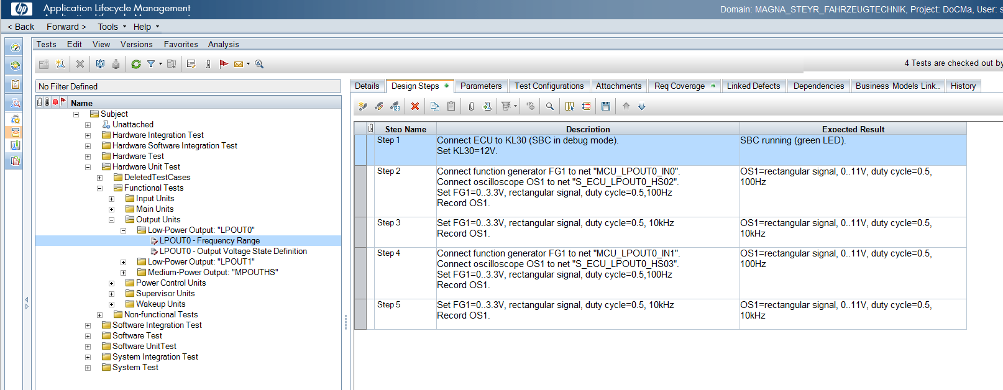


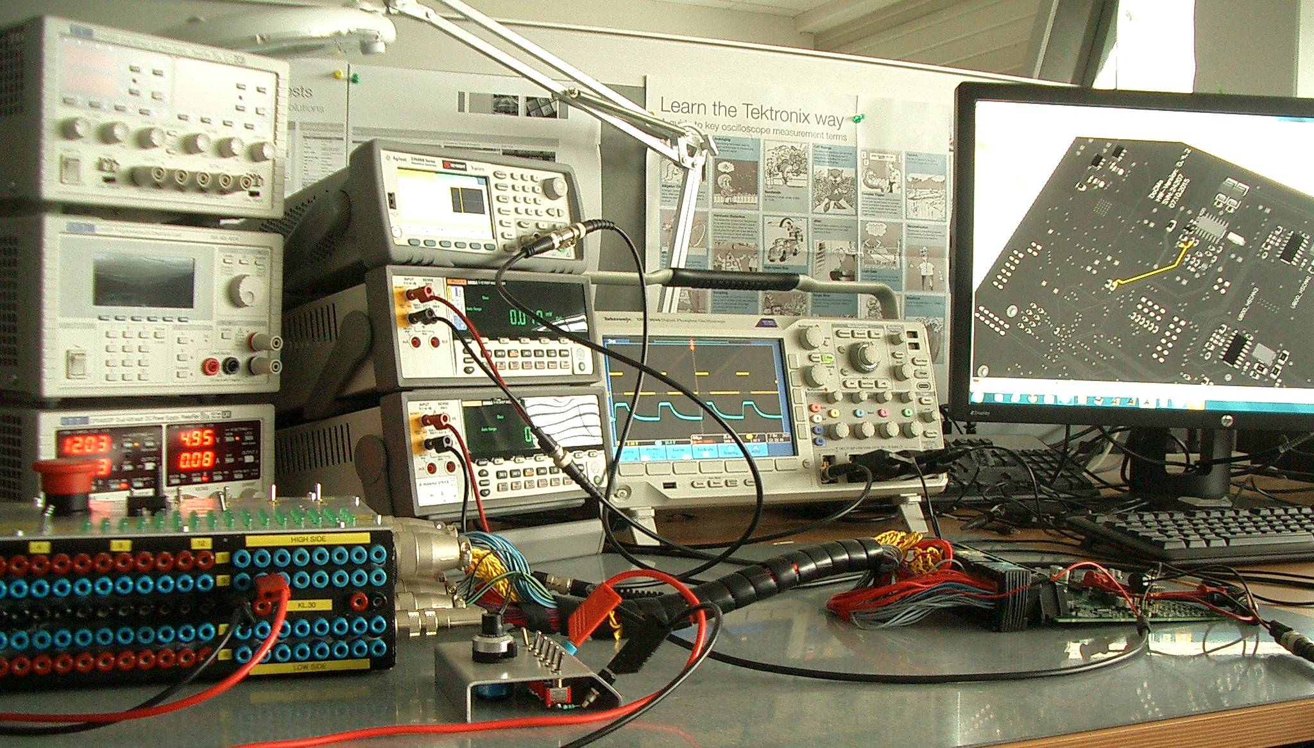

HW Development: Hardware Unit and Integration Testing (HWIT)
Verification of:
  Hardware Architecture and Detailed Design Specification
  Hardware Construction
  Tasks:
  White Box Testing
  Datasheet Limit/Worst Case Conditions
  Design Decision Limits/Worst Case Conditions
  Electrical Testing
  Error Guessing
  Fault Injection Testing
  Unit Tests
  HW Functional Testing
  HW Expanded Function Testing
  Integration Tests
  Internal and external Interfaces Functional Testing
  Expanded Interfaces Functional Testing
  Examples:
  HP ALM Test Specification and Test Steps
  HP ALM Test Results
HWAD
HP ALM: Hardware Unit Test Specification for Low-Power Output “LPOUT0”. Extract with 1 test case and its steps.
HWIT
HW Unit Test: Measurement setup for frequency range upper limits of medium power output driver.

Slide 9
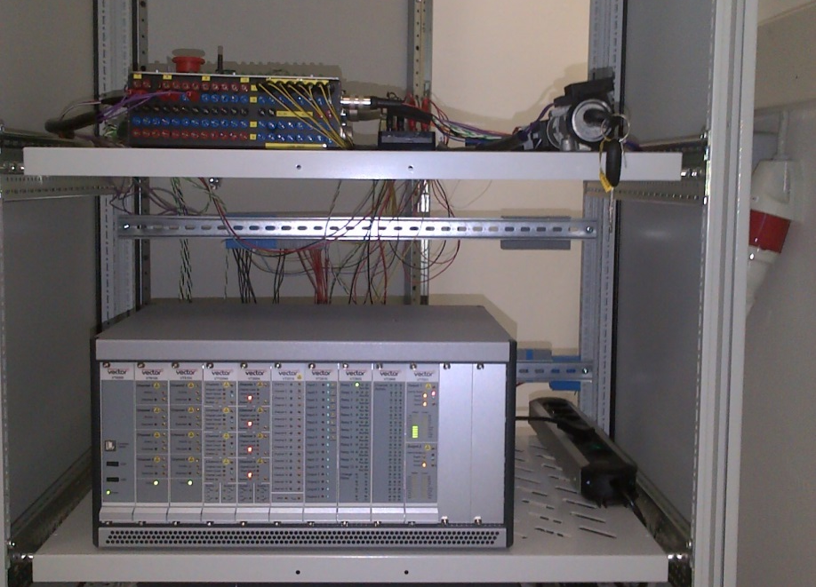
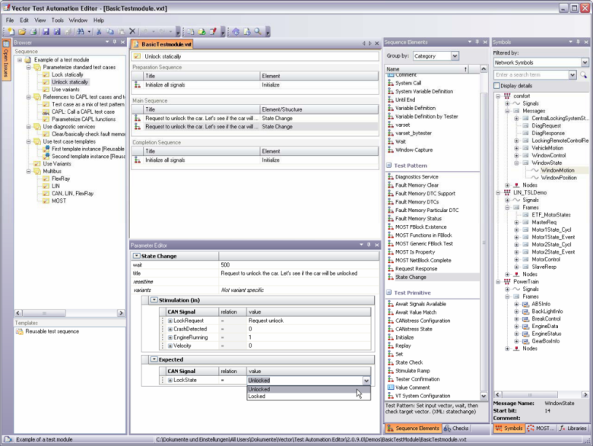

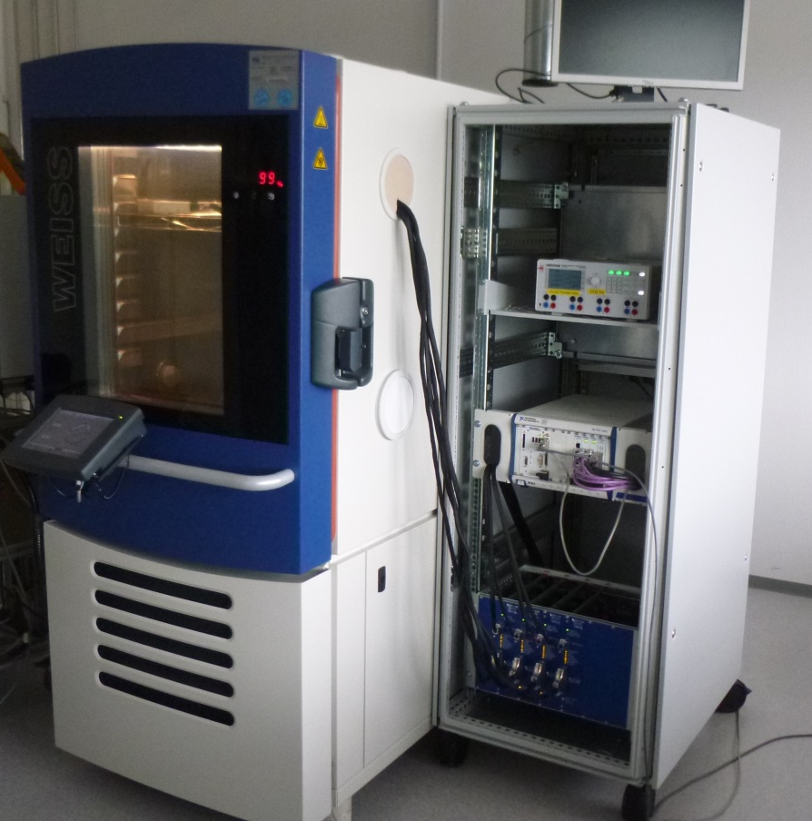
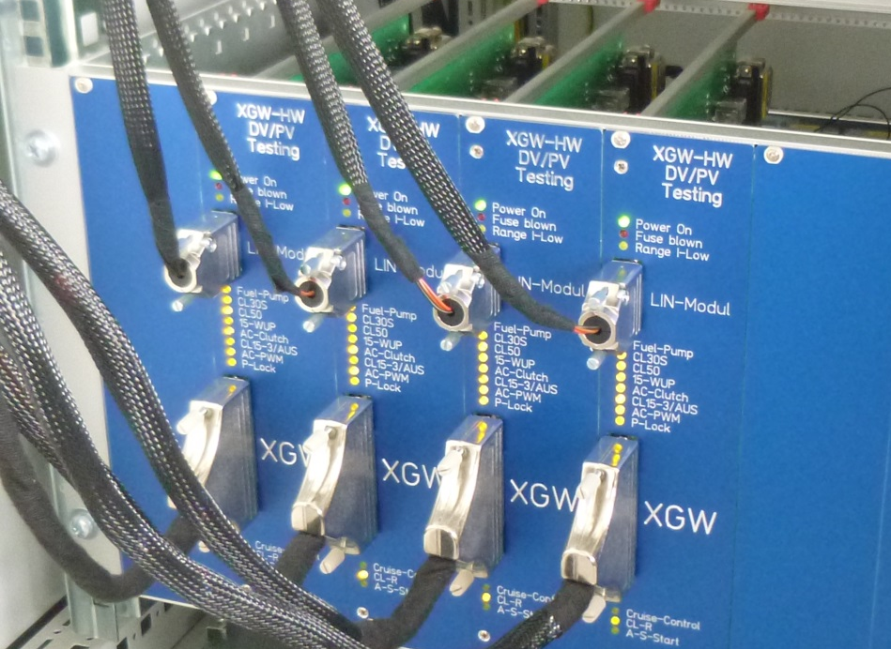
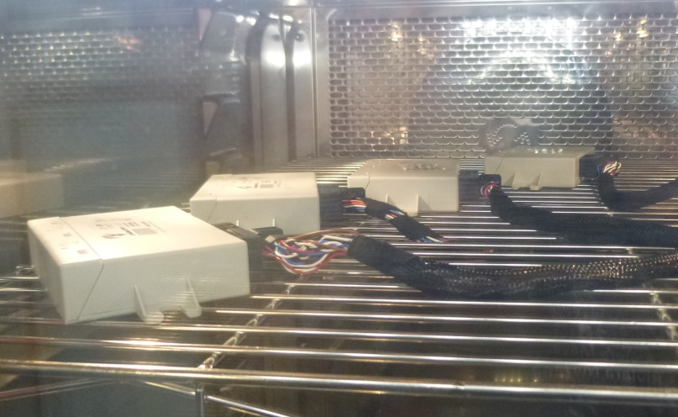

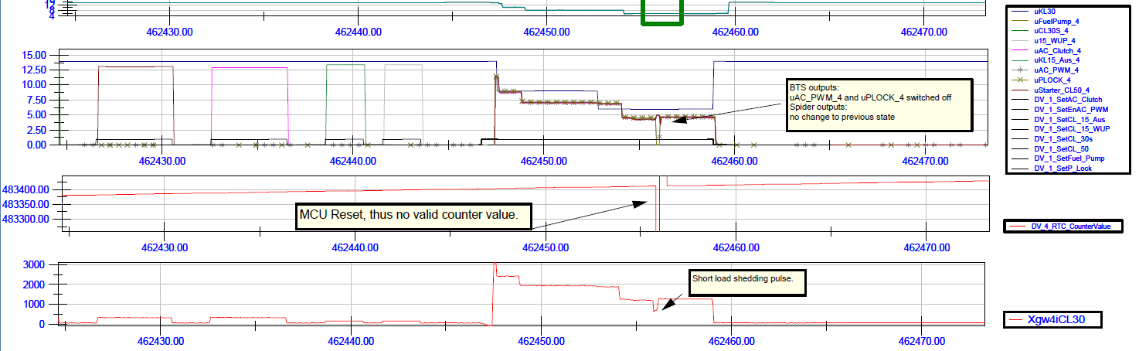

HW Development: Hardware Testing (HWT)
Verification of:
  Hardware Requirement Specification (result of Hardware Requirement Analysis)
  Tasks:
  Test Plan and Test Specification
  Black Box Testing
  Electrical Testing according to OEM/internal standards
  Environmental Testing according to OEM/internal standards
  Examples:
  Hardware Qualification Test Plan Overview XGW
  Hardware PV/DV Test Report XGW
  DIAdem Relay Test Issue Report XGW
HWRA
HiL Testing: Test Bench for electrical Tests
HiL Testing: Test Automation Editor
HWT
PV/DV Tests: Devices under Test
PV/DV Tests: Simulation Boards
PV/DV Test s: Climate Chamber
VT System
DIAdem
Under construction
PV/DV Test Results Verification: NI DIAdem Report Extract

Slide 10
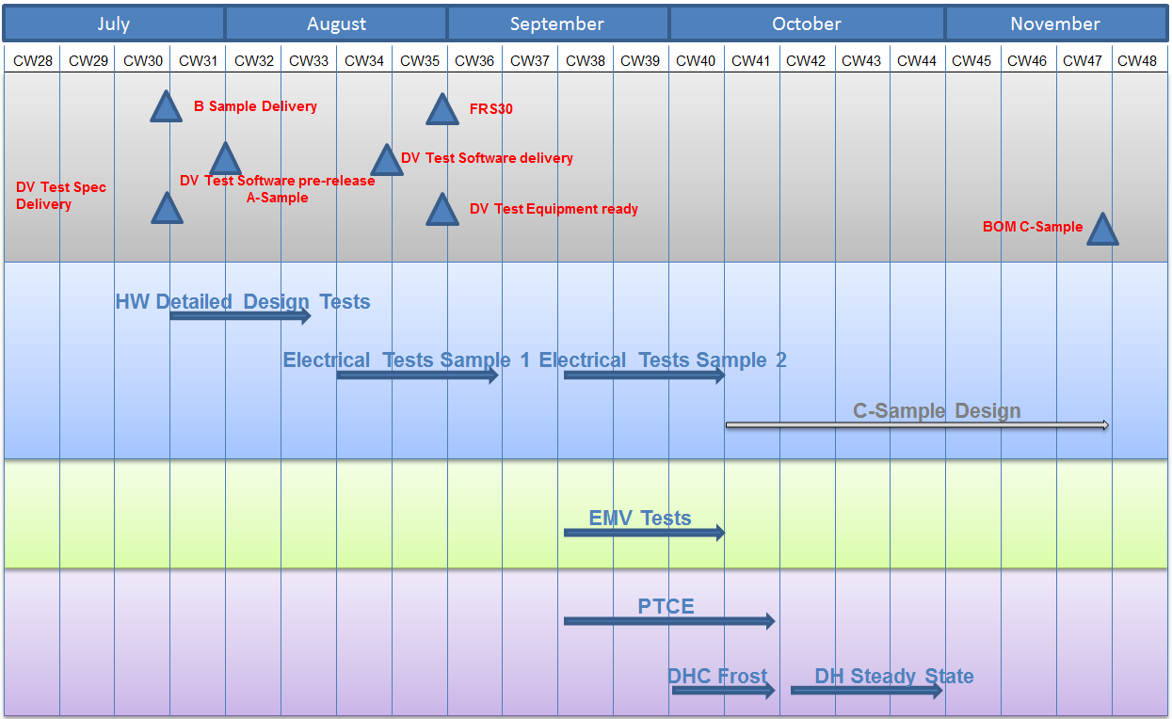
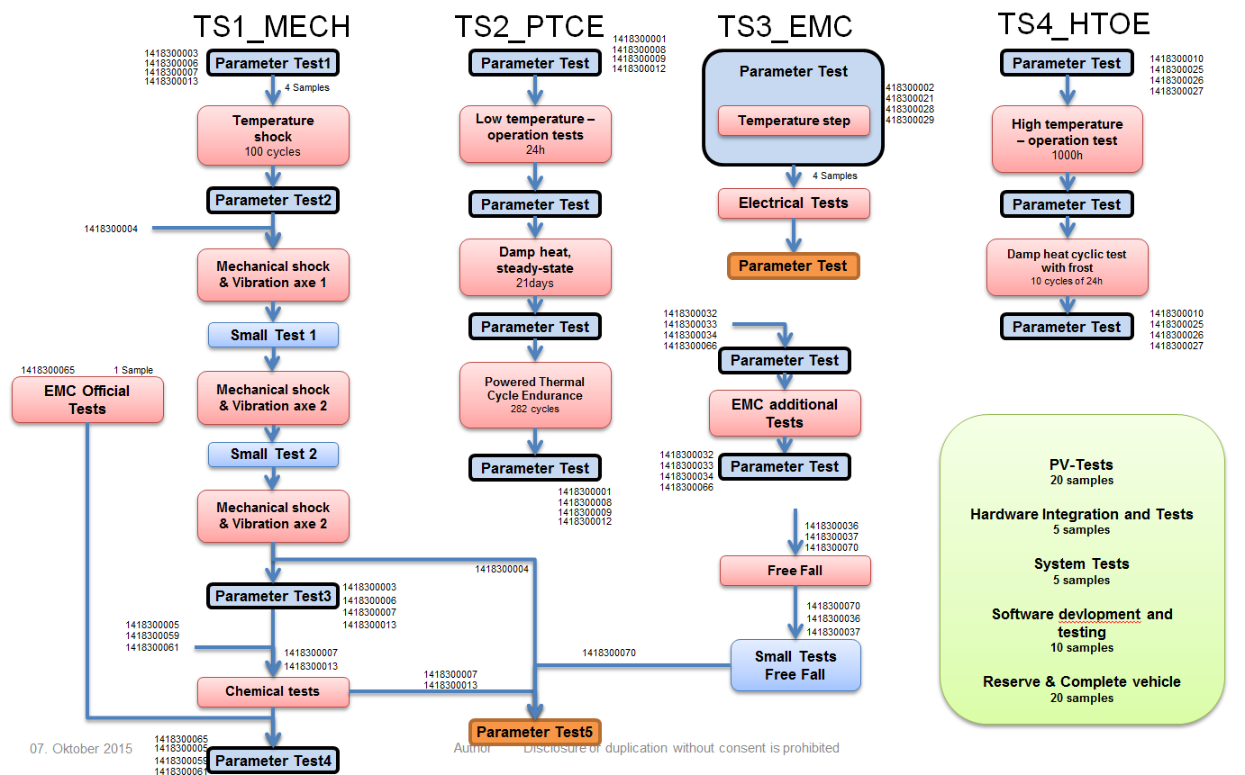
HW Development: Hardware Testing (HWT) – Test plan
Verification of:
  Hardware Requirement Specification (result of Hardware Requirement Analysis)
  Tasks:
  Specify list of tests to be executed on each sample
  Arrange test samples
  Schedule tests according to development schedule
  Plan and supervise testing budget with PM
  Coordinate testing with external test labs
  Examples:
  Hardware Qualification Test Plan Overview XGW

Slide 11
ECU Testing
Hardware in the loop - HiL

Slide 12
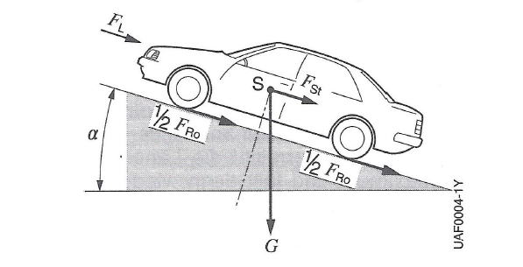



EE Testing – Concepts
Hardware in the Loop and Simulation-based testing
  testing of electrical functions in an early project phase
  reproducible testing, automated testing
  testing is possible long before vehicle prototype is available
  fault injection made easy
HiL benefits:
“Virtual Test Drives”, ECUs connected to a “mathematical model”
environmental conditions change on a click (temperature/slope/friction)
Simulation benefits:
no complex mathematical models needed
easy to extend

Slide 13
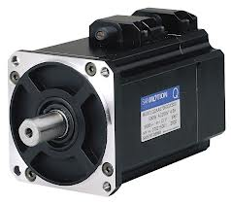
System example - real configuration
ECU 1
CAN
N1, N2, N3
ECU 2
Inverter
Position, Temperature….
DUT
ECU 3
DUT

Slide 14
Hardware In the Loop - configuration
Complete electrical system of the car available
Mathematical Model of simulated hardware part
Test bench testing without real electric motor (no moving parts)
easy fault insertion e.g. motor overcurrent, overheat…
Inverter „thinks“ there´s a real motor
ECU 1
Real Time Target
CAN
N1, N2, N3
Electric Motor Plant Model +
Car Model (pitch, air resistance…..)
ECU 2
Inverter
Interface Hardware
Position, Temperature….
DUT
ECU 3

Slide 15
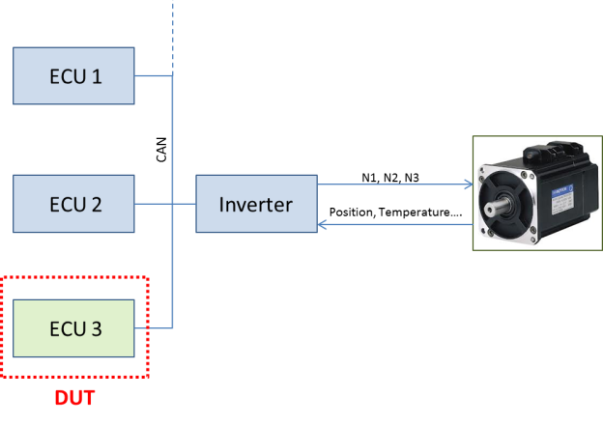
HiL configuration on ECU level
Break Out Box
Power Supply
ECU 3
DUT
PC

Slide 16
Hardware In the Loop – simulation configuration
No real Inverter
no (complex) mathematical models necessary
Inverter simulated on bus level, only necessary A/D signals generated
ECU 1
CAN
ECU 2
Simulated Inverter
HMI
ECU 3
DUT

Slide 17
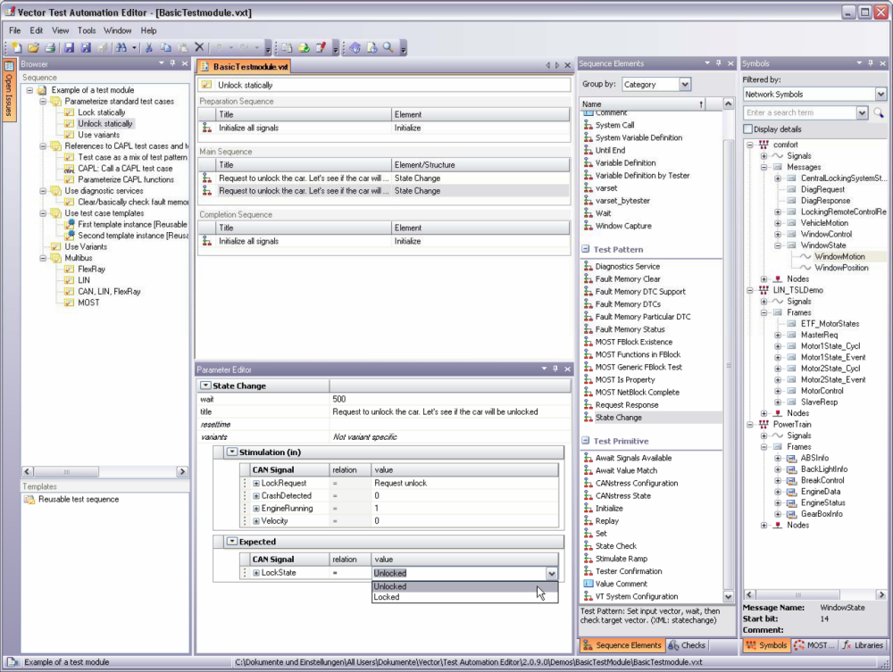
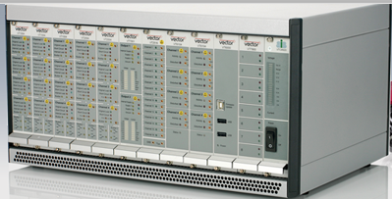
Hardware In the Loop - Tools used
  Test Automation Editor - development environment for creating automated ECU tests
  CANoe - software tool for development, test, and analysis of entire ECU networks and individual ECUs (LINK)
  VT System - Modular Test Hardware comprising bus interfaces, measurement modules, stimulation modules, relay modules…

Slide 18
HiL configuration on ECU level
Power Supply
ECU 3
Break Out Box
VT-System
CANoe
DUT
Parameters
Variables
DBC file data
XML Script
Actuators Sensors
Test Automation Editor

Slide 19
Input documents and work products
» Input Documents
  System Requirement Specification- defined and refined customer requirements/functions on system level
  Standards (IEEE, ISO ….) – standardized communication protocols or standardized diagnostic communication in automotive
» Work products
  System Test Plan- defined Test strategy including test methods, test design technics and regression test strategy
  System Test Specification- including test case specification, test design specification and test environment specification
  System Test Report- Results of all accomplished tests (automated and hand made)
  Traceability Record- All tests have to be traceable to the input document and the next work product

Slide 20
Hardware In the Loop - example
System Test Plan
Creation of System Test Specification
Test Design
Test execution
Handmade
Creation of System Test Report
Verification of System Test Report
Handmade tests
Test Cases
Test Strategy
Automation of test cases
Test Automation Editor
Automated
Automated Tests
Test Logs (typical 100-200 GB per life cycle)
Test Methods
Regression test strategy
One Function Release Step
Next FRS

Slide 21
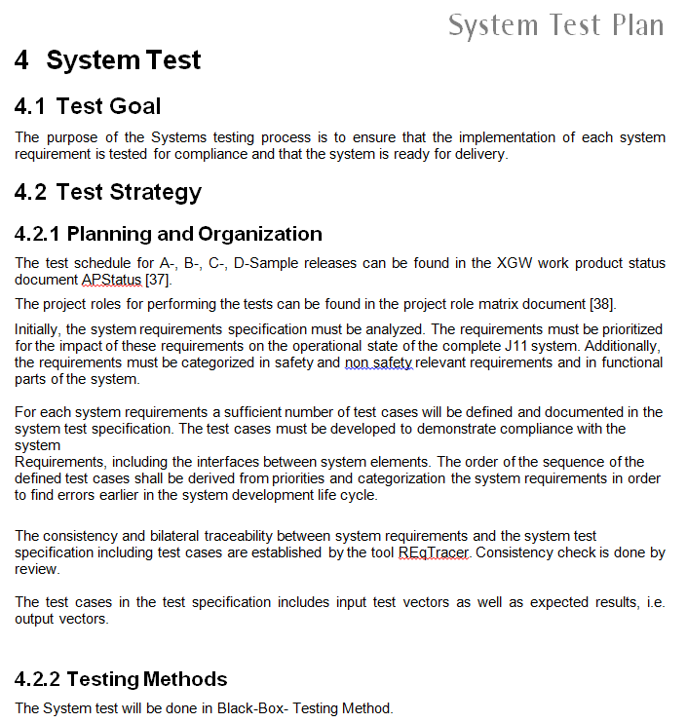
Test Plan

Slide 22
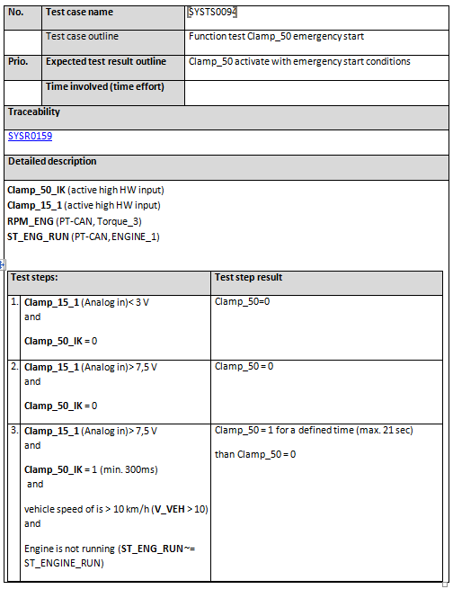
Test Specification
» Document examples

Slide 23
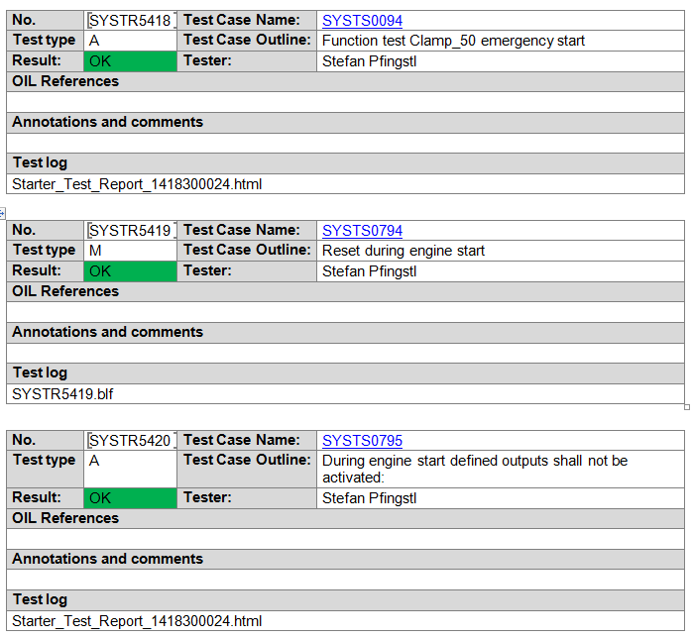
Test Report

Slide 24
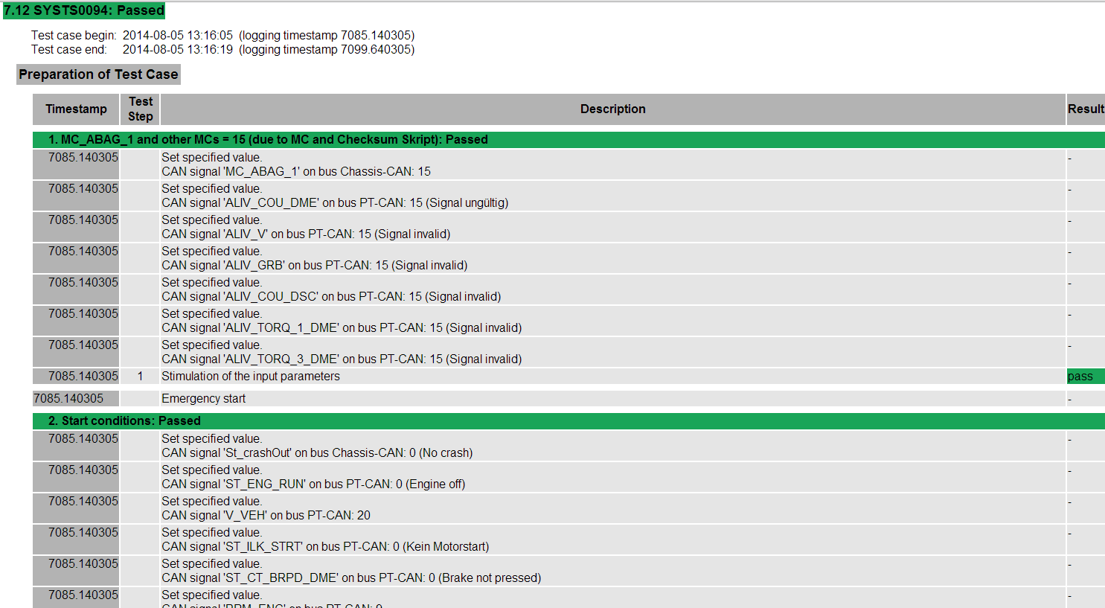
Test Log (automated test)

Slide 25
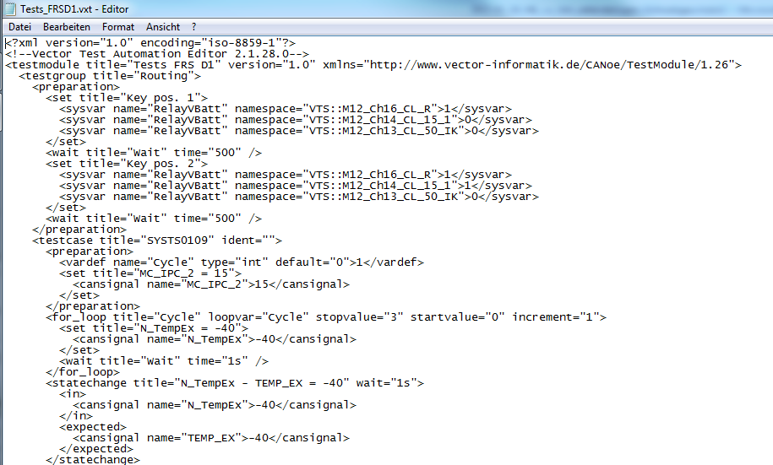
Test file for test automation

Slide 26
System Testbenches

Slide 27
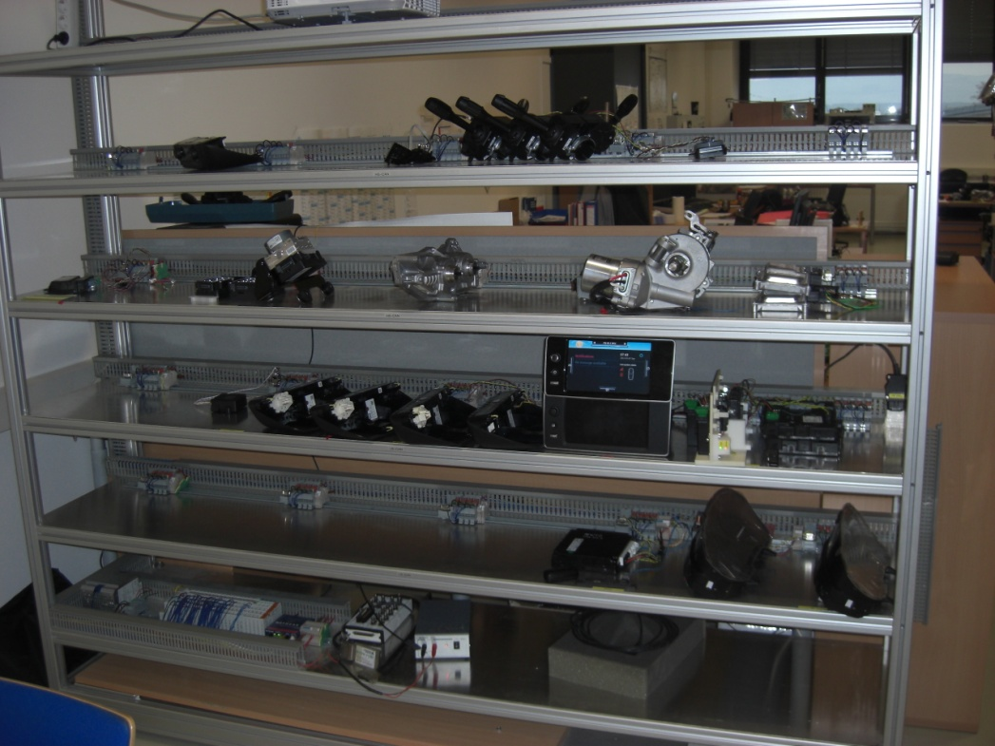
Network testbench
Easy accessible ECUs
All ECUs are connected with supply and bus communication wires to the test bench
E/E system tests can be done before vehicle building starts
Automated tests for diagnostic, bus errors, buslogic, network management, gateway
Fast hardware replacement
No influence from wiring harness

Slide 28
Network testbench – test content
Flash verification
check of the raw data
check of logistic data for/after flash
check the bus behavior by ECU flash
switch off bus at ECU flash

Slide 29
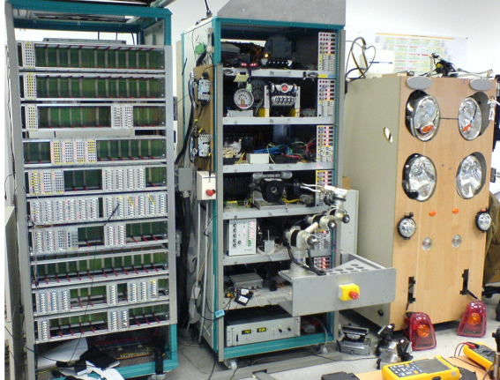
Subsystem (domain) testbench
Automated validation of the complete function-network
Automation of the validation steps incl. automated test report generating, by plugging and switching via Robot for all customer-, long-term-, voltage-, diagnosis- and coding tests.
Automation with 4 engineering tools:
  TestStand
  LabView
  CANoe
  Katana 4D (Robot)
Breakout Rack
Load Rack
ECU´s, operating
elements
Periphery Rack
sensors / actuators

Slide 30
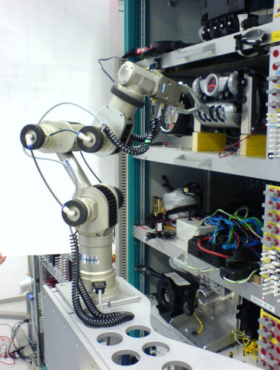
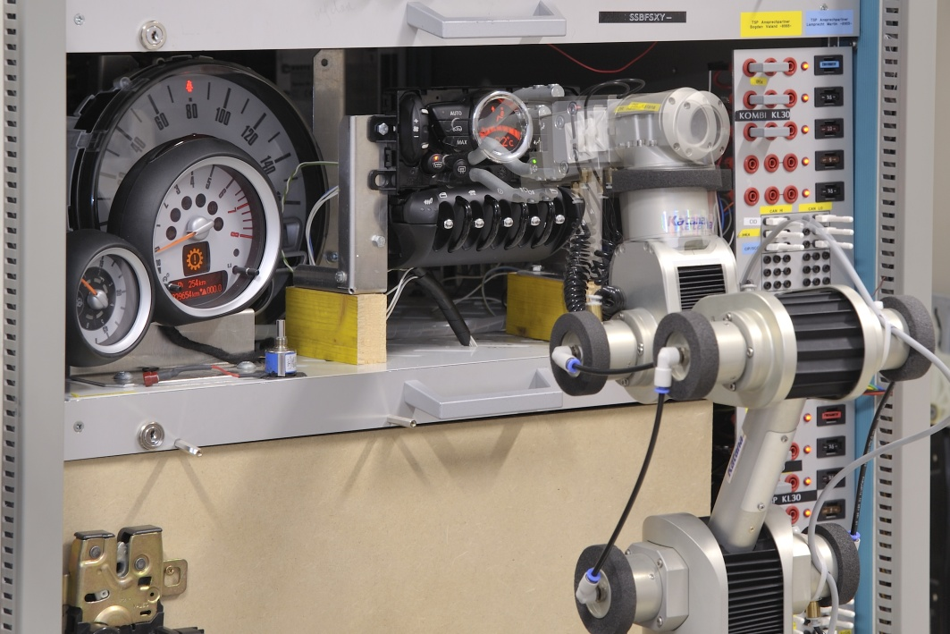
Subsystem (domain) testbench – test content
System functions (partly automated):
  Pinning / wiring (pinning, coding)
  Bus verification (CAN, LIN, Ethernet, etc.)
    Bus-Physic (Error Frames, ramp up/down time, voltage level, load resistor, error simulation)
    Bus-logic (message errors, service messages)
    Bus load (stress impact, power up/down, rest bus simulation stress load)
  Hardware-Signals 1:n connections
  Voltage tests (under voltage, cranking profile, etc.)
  Failure simulation (signal failure, cable failure, ECU malfunction, invalid signals)
  Misuse tests (reverse polarisation, short cut, etc. )
  Flash, diagnostics
  Gateway tests

Slide 31
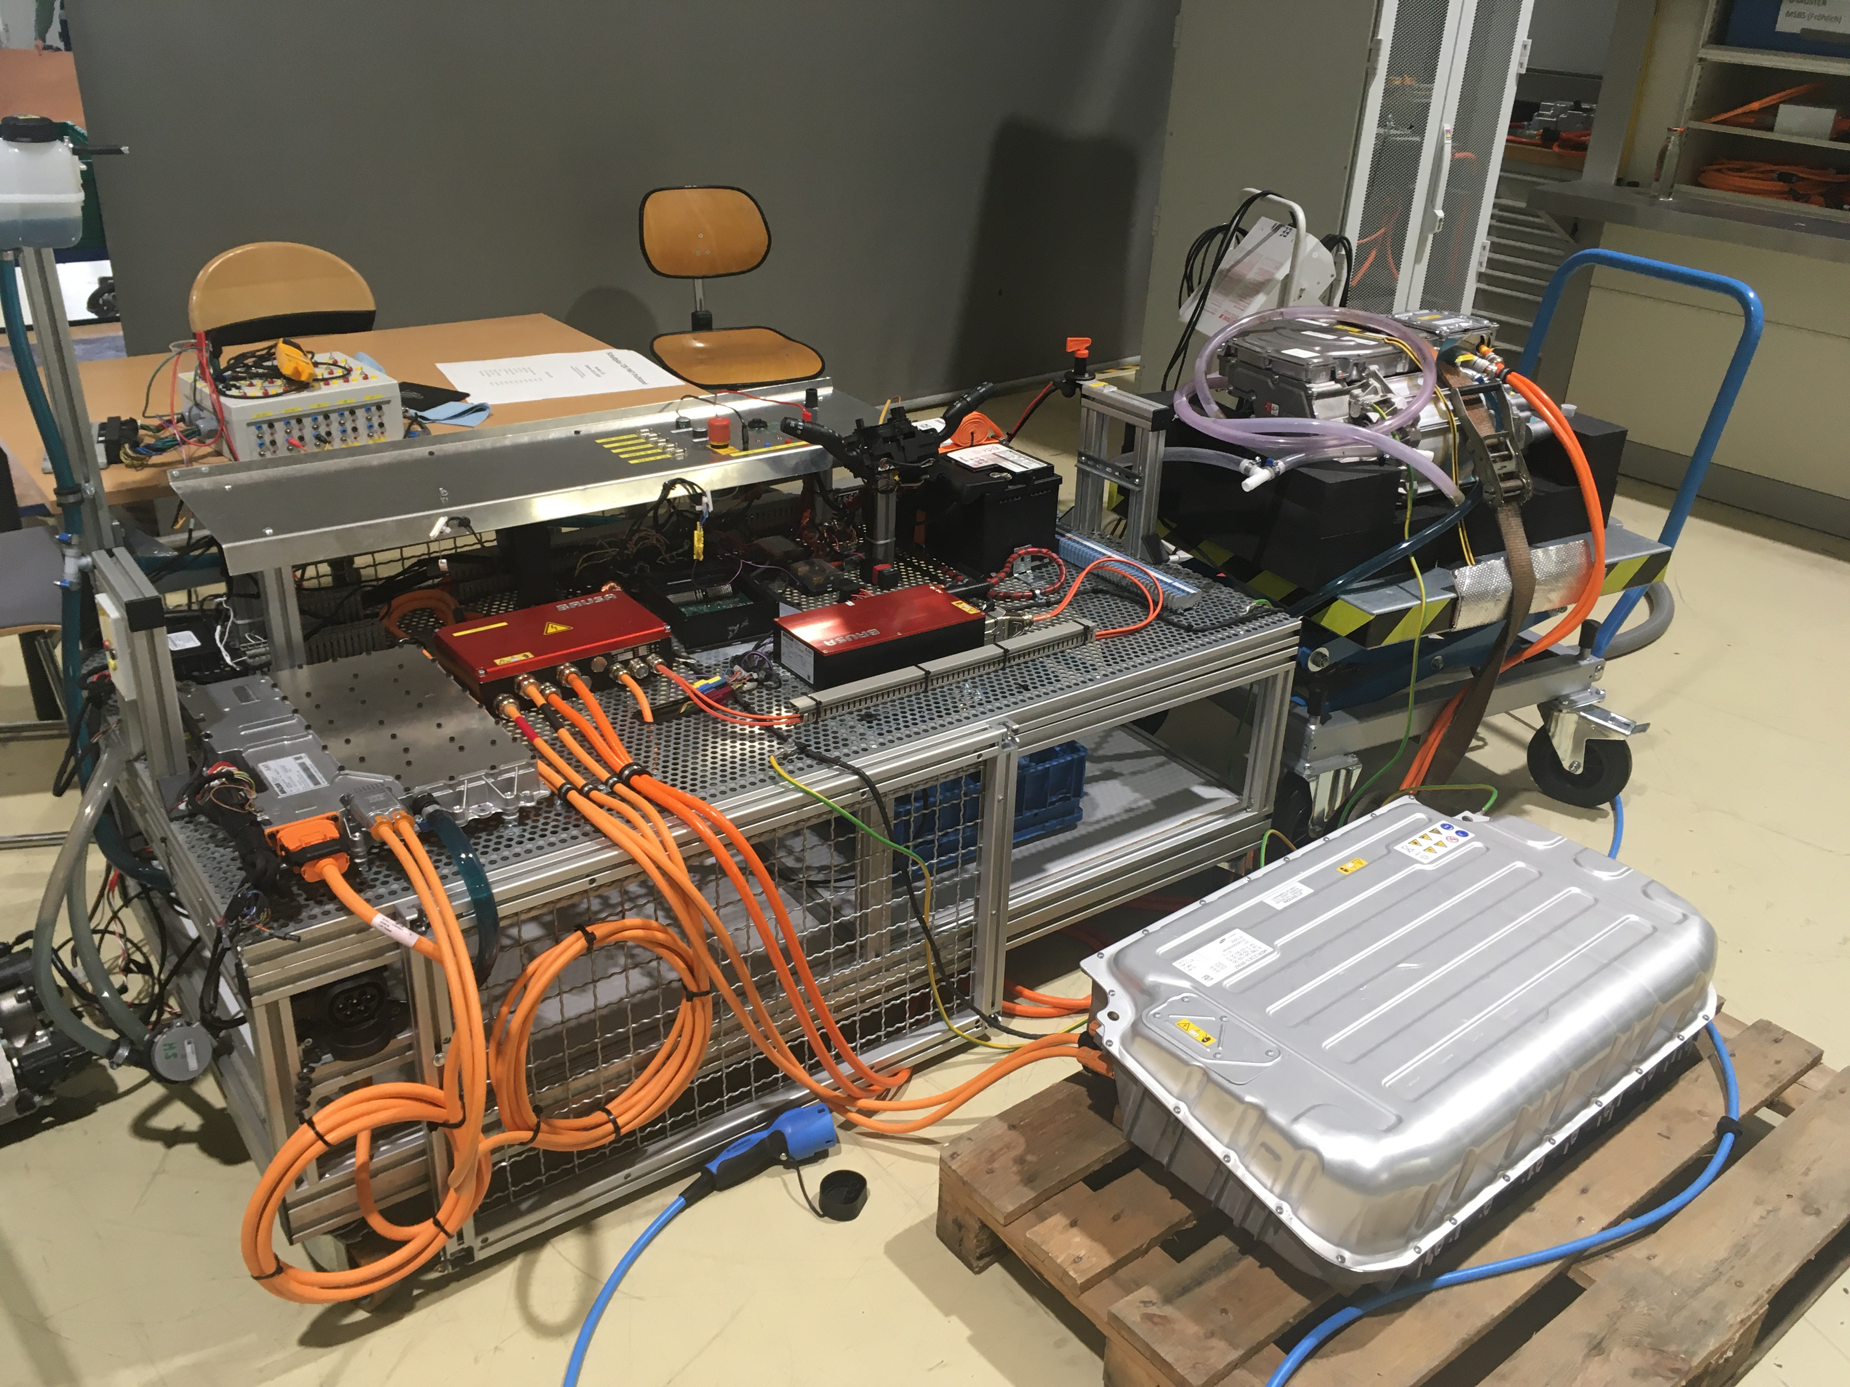
Powertrain Sub System Test Bench
  Test content:
  Verification of local buses (CAN-High, CAN-Low, LIN, etc.)
  Bus-Physic (Error Frames, ramp up/down time, voltage level, load resistor, error simulation)
  Energy-Management (quiescent current, power up/down)
  Bus-logic (message errors, service messages)
  Failure simulation (signal failure, cable failure, ECU malfunction, invalid signals)
  Bus load (stress impact, power up/down, rest bus simulation stress load)
  Misuse tests
  Flash, diagnosis, gateway
  Customer function tests (checklist)
  HV function validation with all HV components
  HW/SW development platform

Slide 32
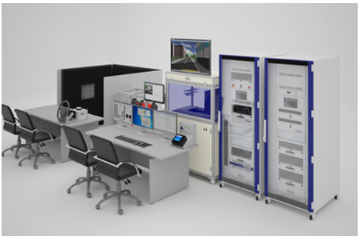
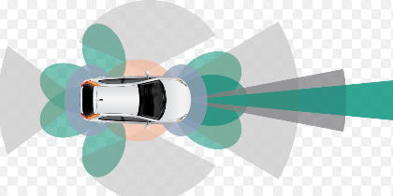
ADAS Sub System Test Bench
  Test content:
  Base customer function testing (with original Components)
  Static maneuver testing (Ideal virtual world)
  Failure/Manipulation/Stress testing (Wiring/ECU/Sensor/Actuator failures)
  HMI Validation (functionally)
  EE maturity monitoring
  Vehicle Configuration and Vehicle variant testing
  Safety robustness validation
  Automated testing, Repetitive testing, Long-time testing and Variation testing
  Free and stochastic testing and error analysis

Slide 33
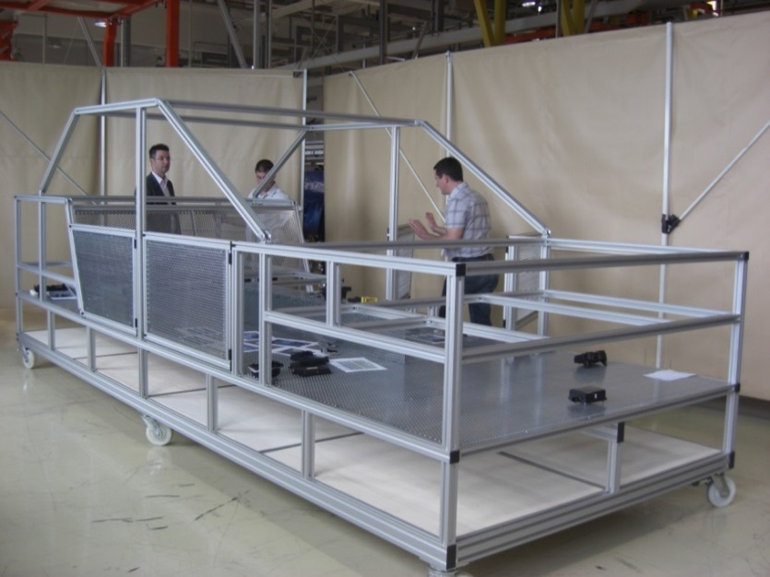
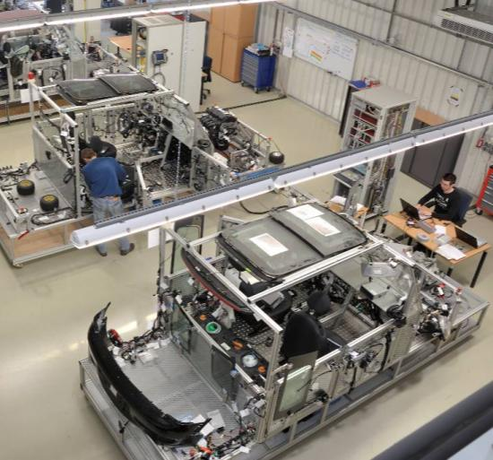
Laboratory Vehicle (Labcar) - Overview
Aluminium frame
Easy accessible ECUs and harness
Fast hardware replacement without disassembling the complete vehicle
Original vehicle wiring harness and all ECU´s, sensors and actuators are integrated into the test platform.
Complete system tests can be done before vehicle building starts
Automated test sequences (LabVIEW, CANoe, C#)
HIL-Simulation (NI, dSPACE)
Residual bus simulation for missing ECU´s

Slide 34
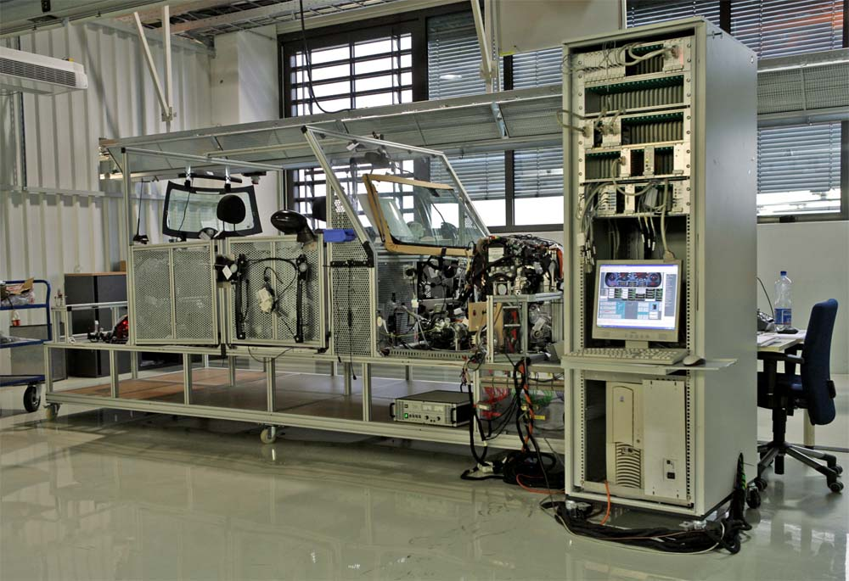
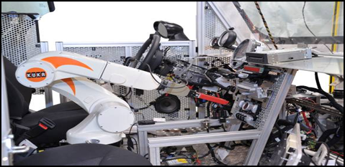
Laboratory Vehicle (Labcar) – test content
E/E system function tests
  wiring harness validation
  flashing/coding verification
  physical/logical bus layer tests (CAN,LIN, Ethernet)
  clamp control tests
  network management tests (Autosar)
  hardwired signal measurements
  voltage tests according specification (ISO 16750-2, LV124,…)
  quiescent current measurements
  power management functions
  diagnostic function tests
  gateway tests
Customer function tests

Slide 35
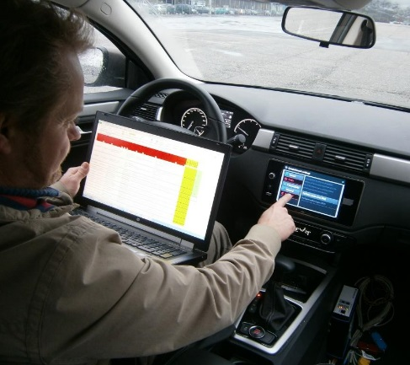
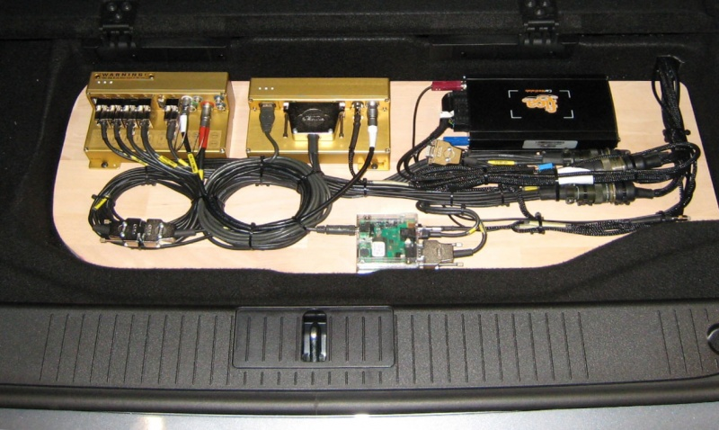
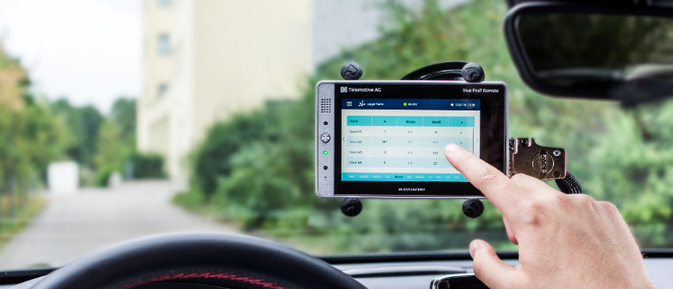
Vehicle Intensive Test (VIT)
Assembling and Configuration of special measurement equipment
Assembling of data logging equipment for AnalysisVehicle upgrades incl. flashing of the control units and error analysis
Mechanical and electrical Vehicleupgrades
Commissioning of complete vehicles at the customer and at the PT Shop incl. Flashing, Coding and Functioncheck.

Slide 36
Vehicle Intensive Test (VIT) – test content
Validation of system and customer function tests incl. stochastic tests during off-duty testdrives
“Free testing”
  Reproduce typical consumer behavior
  Reproduce misuse
Summer/wintertestdrives and special component trails on different countries. (e.g. head unit, navigation)
Support of product demonstrations on trade shows
Vehicle build up support on the in-plant production line

Slide 37
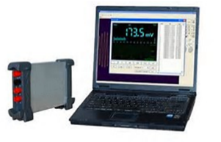
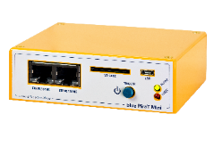

Tools: Data Loggers
EMC compliant? | yes | no
Placement close to ECU’s? | yes | not always
Interfaces for all bus technologies? | yes | no
Testing without manual? | yes | no
Invisible for the driver? | yes | no
Temperature range (-40° to 60°C)? | yes | no
Shock resistant? | yes | no
Autonomous logging? | yes | no
Second driver needed? | no | sometimes

Slide 38
System Testing
Front Wiper Example

Slide 39
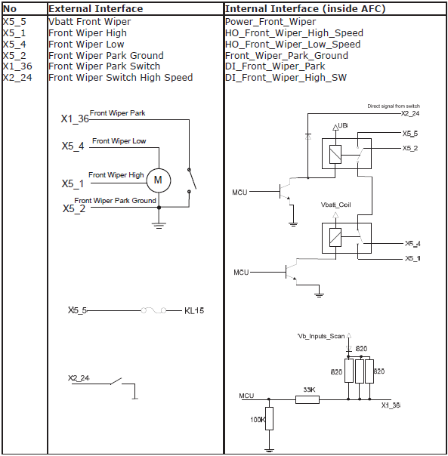
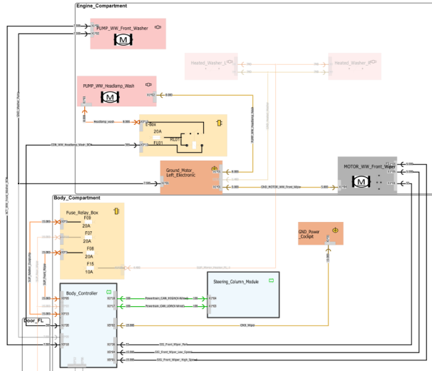
Hardware In the Loop - example
ECUs which are operating the front wiper assembly are physically available
ECUs which are not “driving” the front wiper are simulated
DUT
ECU
Body Controller
Front wiper
CAN
ECU
Terminal Control
Wired
ECU Simulation
(CAN-based)
- Vehicle Speed
Lever Position
Engine State
Measurement HW
CAN signals
A/D signals

Slide 40
Front wiper testing – ECU Simulation
  Engine management system (EMS) simulation for Engine State
  Electronic stability control (ESC) simulation for Vehicle Speed
  Steering column modules (SCM) simulation for Lever Position
From specification
5.3.2 Interface Requirements
5.3.2.2 CAN Signal Inputs
Signal Logical Name | Description
C_FrontWiper_LowSpeed_SW_ST | Front wiper low speed switch input on CAN - SCM
C_FrontWiper_HighSpeed_SW_ST | Front wiper high speed switch input on CAN - SCM
C_FrontWiper_IntermSpeed_SW_ST | Front wiper intermittent speed switch input on CAN - SCM
C_FrontWiper_MistMode_SW_ST | Front wiper mist mode switch input on CAN - SCM
C_FrontWiper_Interval_SW_ST | Front wiper interval switch input on CAN - SCM
C_FrontWasher_SW_ST | Front washer switch input on CAN - SCM
C_VehicleSpeed_ESC | Speed information from ESC ECU- ESC
C_EngineState_EMS_ST | Engine state status from EMS ECU - EMS

Slide 41
Front wiper testing – Measurement
  A/D signals to monitor
  CAN signals
From specification
5.3.2.2 Digital Inputs
5.3.2.3 Digital Outputs
Signal Logical Name | Description
HW_Ignition_ST | KL15 power supply input
HW_FrontWiper_Park_SW_ST | Front wiper park switch status
Signal Logical Name | Description
HW_FrontWiper_OnOff_CMD | Front wiper power enable relay output
HW_FrontWiper_HighLow_CMD | Front wiper high/low speed relay output
HW_FrontWasher_CMD | Front washer output
HW_HeadlampWasher_CMD | Headlamp washer output

Slide 42
Front wiper testing – Speed Mode Test
From specification
5.3.5 Function Requirements
5.3.5.4 Front Wiper Intermittent Mode
Dwell Time of Front Wiper Intermittent Speed Class Mode
ID: FRS_AFC_FWP_018:
There are 5 speed class variations available with 4 dwell times in each class. The dwell time should only be changed from one vehicle speed class to another vehicle speed class when the wiper motor is in park position.
Interval Adjust switch position | Vehicle speed class (kph)
 | V0 (<5) | V1 (32) | V2 (<64) | V3 (<96) | V4 (>=96)
Interval 1, dwell time in s | 24 | 16 | 12 | 10 | 8
Interval 2, dwell time in s | 15 | 10 | 8 | 6 | 4
Interval 3, dwell time in s | 8 | 5 | 4 | 3 | 2
Interval 4, dwell time in s | 3 | 2 | 2 | 1 | 1
Default, dwell time in s | 8 | 5 | 4 | 3 | 2

Slide 43
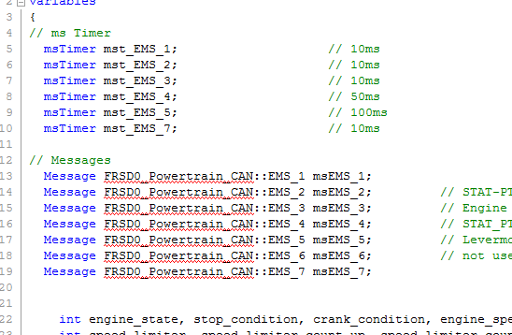
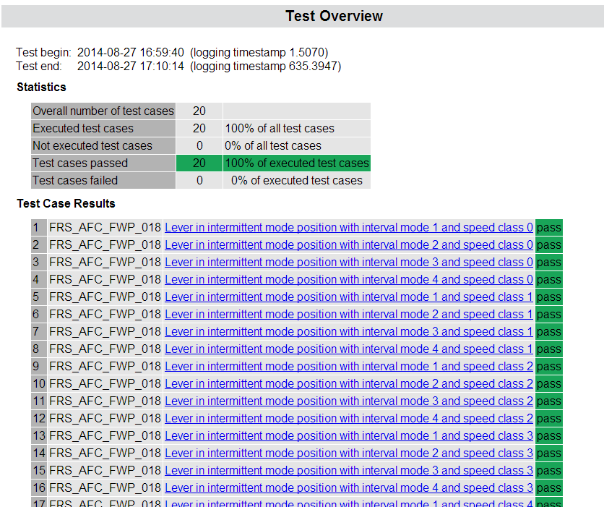
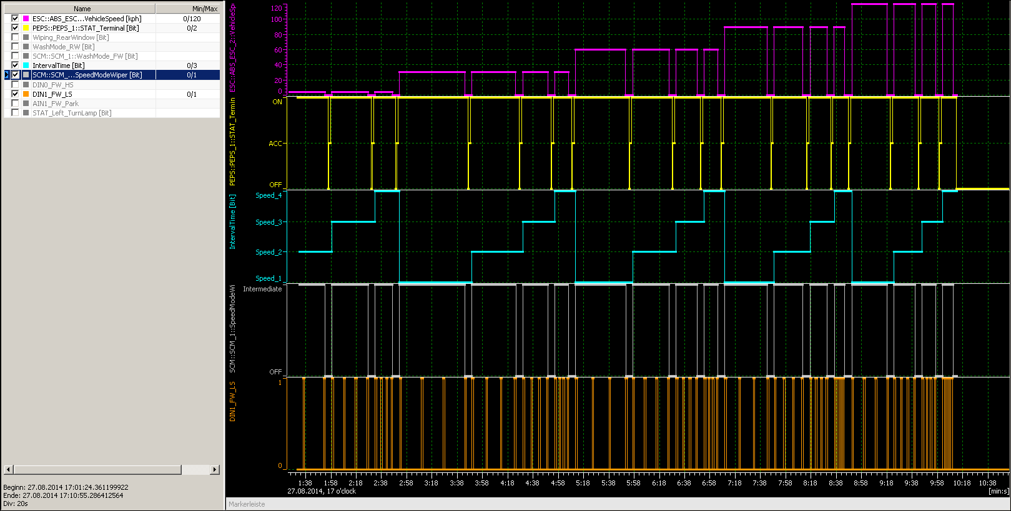
Wiper Speed Mode Testing – Test sequence
  Prepare test environment (supply voltage, parameter sets, simulated ECUs…)
  Prepare test modules
  Start testing
  Test report generation

Slide 44
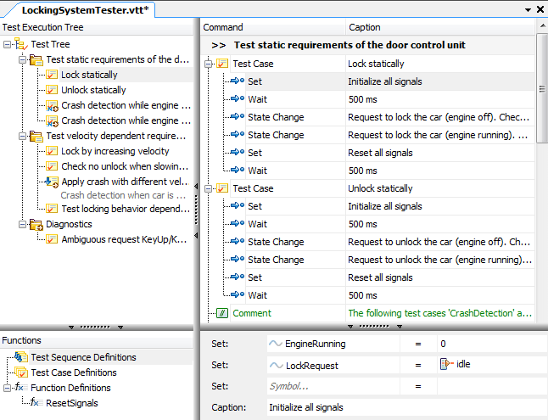
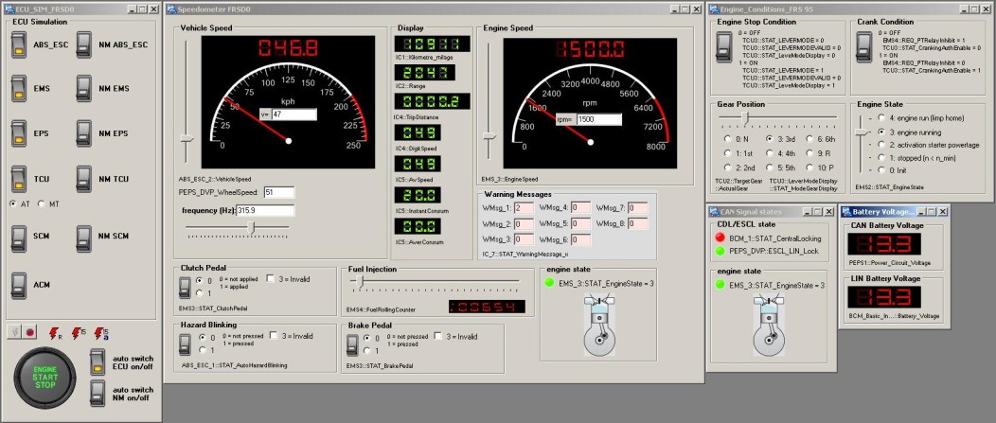
Hardware In the Loop - Tools used
  vTESTstudio - development environment for creating automated ECU tests
  CANoe - software tool for development, test, and analysis of entire ECU networks and individual ECUs (LINK)
  VT System - Modular Test Hardware comprising bus interfaces, measurement modules, stimulation modules, relay modules…

